Slide 1
Healing Trauma through Mindfulness and Yoga WIB Oct. 3-4, 2020
Sharon A. Suh, Ph.D.
Seattle University
200 hr. RYT, T.I.Y trained, Y4T certification, ME-CL Level II Trained Teacher
Notes:
Capacity to be with the difficult and the challenging

Slide 2
“Awareness leads to choice and choice leads to freedom.”
Moving from Reaction to Response
and response-ability
Notes:
“Being oppressed means the absence of choice,” bell hooks reminds us and this absence of choice can threaten our very ability to decide we react and respond to potential and real danger.

Slide 3
What is Trauma? Where does it live?
“Trauma is much more than a story about something that happened long ago. The emotions and physical sensations that were imprinted during the trauma are experienced not as memories but as disruptive physical reactions in the present…”
Neuroscience research shows that the only way we can change the way we feel is by becoming aware of our inner experience and learning to befriend what is going on inside ourselves.” – Bessel van der Kolk, The Body Keeps the Score
Notes:
In my vocation as a feminist Buddhist scholar and practitioner, I center the body as a focus of compassionate self-awareness and self-love and draw direct explicit attention to acknowledging our embodied being in order to notice our bodily sensations and reactions to things gone amiss and awry.
In the game of making it in the professional world as women of color, it should come as no surprise that, as neuroscientist Bessel van der Kolk famously declared, the “body keeps the score” and if we do not pay attention, imperialist white supremacist capitalist patriarchy may win.
Attending to our inner experiences through mindfulness and meditation as a way to development awareness, choice, and freedom thus includes an attunement to the effects of the compulsions of white supremacy in our institutions in order to find safety and refuge in the body when the institutions that invite us in do not necessarily desire to see us thrive.

Slide 4
What is Trauma?
The absence of choice
Natural reaction to unnatural experiences or to overwhelming experiences.
Trauma as a survival response in the body
Events for which we had no choice
Any experience that overwhelms our experience to cope
“For real change to take place, the body needs to learn that the danger has passed and to live in the reality of the present.” Bessel van der Kolk
Notes:
Trauma is an EVENT that is EXPERIENCED that has lasting EFFECTS. The foreclosure of choice surrounding what happens to one’s own body is the very epitome of trauma.
Trauma specialist Judith Herman explains in Trauma and Recovery, “[t]he core experiences of psychological trauma are disempowerment and disconnection from others.” As women of color, many of us have become habituated to the daily effects of oppression in our academic institutions and disciplines, spaces that often compromise our integrity and difference while purportedly thriving because of our very embodied raced, gendered, and sexed specificity. Yet, this habituation comes at a cost which is the additional labor of being labeled different by virtue of your corporeal existence. Judith L. Herman, Trauma and Recovery: The Aftermath of Violence – from Domestic Abuse to Political Terror (New York: Basic Books, 1992), 133.
Because we are living in an increasingly racialized world where racism has become even more normalized, we may feel that are under the surveillance and public scrutiny which requires us to constantly self-check and even constrain our identities through how we dress, speak, and act in meetings, classrooms, and other public spaces of gathering. The impact of this pressure to contort ourselves into acceptability alongside the margins of whiteness leaves its imprint in the body as we work to fit into a system that works to maintain our misalignment with its norms.

Slide 5
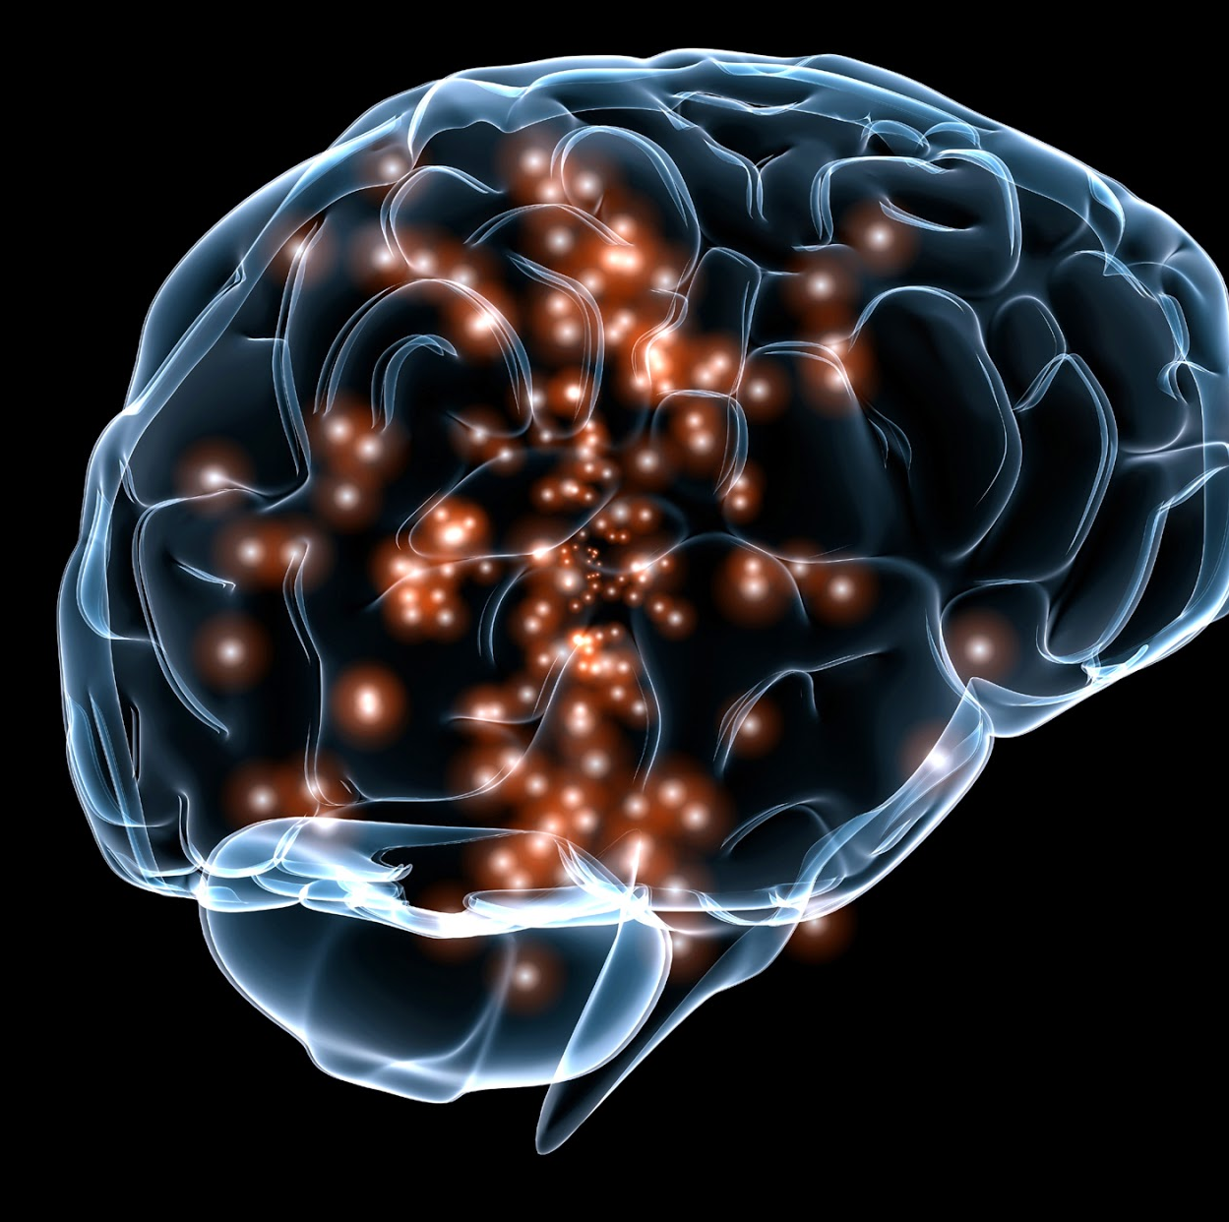
What are Triggers?
A trigger is a physiological response outside of the survivor’s control that remind them of past trauma.
Symptoms of trauma can remain dormant, accumulating over years or even decades.
Then, during a stressful period, or as a result of another incident, they can show up without any warning (Peter Levine).
This Photo by Unknown Author is licensed under CC BY-NC-ND
Notes:
This survival mechanism kicks in when forced to conform to and abide by the rules of dominator culture (of which the academy is no stranger and no innocent bystander) in order to confirm its presumed legitimacy. We cannot allow ourselves to publicly register the very real struggles in the white institution in order to make our way, yet the high levels of stress, anxiety, and health crises experienced by women of color are direct measures of the psychic effects of racial, sexual, and gender violence in our professional lives.
We suffer, but we suffer in silence behind closed doors and our bodies continue pay the price.
The game requires us to play by the rules, which are often stacked against us and not equally measured.

Slide 6
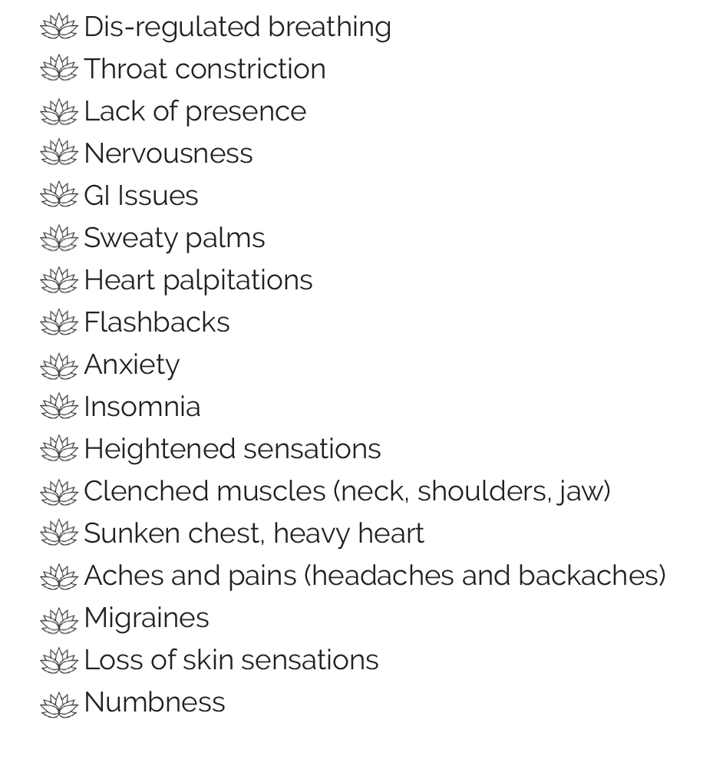
Common symptoms of trauma and triggers

Slide 7
Types of Trauma
Shock trauma as a one-time event like natural disaster or accident
Cumulative or Complex trauma- occurs over time within specific settings and scenarios- child abuse, sexual abuse, incarceration, racism, domestic violence, an abusive boss.
Historical and intergenerational trauma experienced by entire communities which leaves emotional, psychological, and physical wounds. Examples: slavery, genocide, forced relocation, poverty, destruction of cultural practices.
Big T trauma- large scale event
Little t trauma- “death by a thousand paper cuts” such as microaggression
Race-based Trauma

Slide 8
But why focus on trauma? Because we all have it
70% experience at least one Big T event in their lives
30% experience 4 or more Big T events in their lives
Most people don’t experience PTSD and other forms of Complex Trauma, but 20% due
Acute Stress Disorder- symptoms fade within a month or so
PTSD and Complex trauma symptoms continue through time and affect the brain and physical health
PTSD responses are normal survival responses to unusual events, but often trauma survivors can’t distinguish between real and past dangers
Notes:
The mindfulness generated from somatic awareness practice builds our own capacity to love self and other

Slide 9
Mindfulness as “skillful” action according to the Buddha
Paying attention to the interconnectedness between the body and mind
Increased capacity to be with the uncomfortable
Understanding nature of thought and emotions
Recognizing habit patterns and conditioned behavior
Can bring us back into present moment awareness
Can bring us back into the body

Slide 10
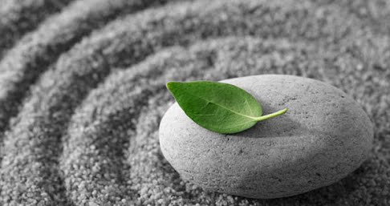
Trauma as embodied experiences that mindfulness illuminates
Mindfulness helps us notice when we are getting into the trauma vortex so we can do what we need to be safe, or safe enough
Mindfulness develops resources to help bring us back into present moment awareness because when we are triggered we are often stuck in the past
Mindfulness through meditation and movement helps the body know that it is safe
This Photo by Unknown Author is licensed under CC BY-ND
Notes:
Training in mindfulness, mindful eating, and trauma-sensitive yoga may seem unusual and perhaps unbecoming of a university professor, but for me it signifies my commitment resist the conceit that our acceptance in the academy must necessarily come from ignoring our bodies which are the archives of our past traumas. To continue to ignore the body and avoid healing the injuries of white supremacy means to accept a slow death in our wellness, agency, and resilience. Coming back to the body to find one’s footing in the midst of imperialist white supremacist capitalist patriarchal violence is a political survival strategy.

Slide 11
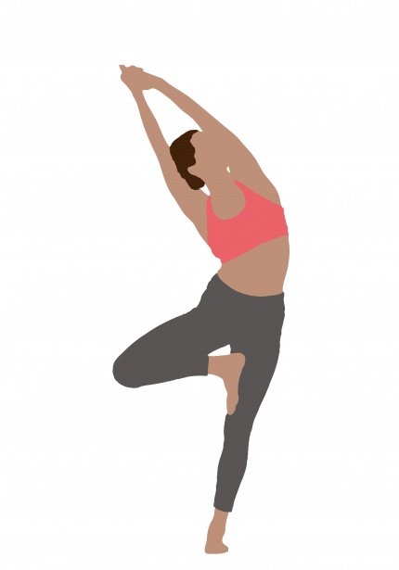
Benefits of practicing mindfulness and embodied practices such as yoga
Strengthens your ability to switch from reactivity when triggered and emotionally dysregulated and the neocortex goes off-line to skillful response
Normalizes unpleasant sensations and weakens the impulse to push away unwanted feelings
Increases your ability to distinguish between past, present and future and helps you stay in the present, even if unpleasant without the situation needing to change
Long term meditators can hold onto joyful experiences longer!
Enables you to appropriately discern real and present danger from past triggers and/or future fears
Notes:
The embodied knowledge and felt-sensations of foul play that our bodies register are witness to the fact that the game we have been playing has been rigged in favor of able-bodied cis-gendered heterosexual white men; yet we persist in the hopes of transforming the rules and academic disciplines themselves.

Slide 12
Some Practices for Healing
Noticing the Connection between Emotions and Physical Sensations
5-7-8 Breathing
Compassionate Touch Meditation
This Photo by Unknown Author is licensed under CC BY-SA

